Slide 1
Spanish postal code content-based recommendation system
Adrián Rejas
IBM Data Science Certificate capstone project

Slide 2
Index
Introduction
Data to use
Methodology
Results
Discussion
Conclussions

Slide 3
Introduction
When people need to move into another city, choosing the right area to live in the new city could be a challenge.
Limited knowledge
Postal code areas: universal city areas demarcation
Project idea:
Design a content-based recommendation system for choosing the postal code area to live in a new city

Slide 4
Introduction
Similarity option
Density option
Recommends postal code areas more similar to a reference postal code.
Inputs:
Reference postal code.
The city to move in.
Amenities of interest.
Recommends postal code areas with highest density of venues
Inputs:
The city to move in.
Amenities of interest.

Slide 5
Introduction
First approach:
15 most populous cities of Spain.
Target users:
People living in Spain or thinking about moving into Spain.
People thinking about moving into another home in the same city or in another one.
People who consider the amenities of the area as an important feature for choosing a home.

Slide 6
Index
Introduction
Data to use
Methodology
Results
Discussion
Conclussions

Slide 7
Data to use Spanish postal codes info
Data gathered for each postal code:
ID of the postal code area.
City where the postal code area is located.
Geographical boundaries of the postal code area in the form of GeoJSON file.
Source (Thanks to Inigo Flores):
https://github.com/inigoflores/ds-codigos-postales
Cities data: 15 most populous cities of Spain.
Cities data source: handmade JSON.

Slide 8
Data to use Venues at each postal code
Data gathered for each postal code:
Number of venues in the area.
Venues of the area, with the following info for each of them:
Venue name.
Venue location.
Venue category
Source:
Foursquare REST API

Slide 9
Index
Introduction
Data to use
Methodology
Results
Discussion
Conclussions

Slide 10
Methodology
Development environment
Data obtention
Data processing
Build recommendation algorithm
Build visualization tools
Build application

Slide 11
Methodology: development environment
Programming code: Python.
Well suited for data science projects.
Main libraries used: Pandas, Scipy, Folium, iPython, Geocoder.
Source code container: Jupyter notebook.
Required by the project.
Portable.
Flexible.
Running environment: Anaconda Python distribution
Runs locally.
Cloud-based environments also usable: IMB Watson, LabsCongitive.ie, Kaggle …

Slide 12
Methodology
Development environment
Data obtention
Data processing
Build recommendation algorithm
Build visualization tools
Build application

Slide 13
Methodology: data obtention
Cities data:
Created handmade JSON.
Transformed into pandas dataframe.
Location obtained by ArcGIS Geocoder.
Postal codes data:
CVS and GeoJSON files got from https://github.com/inigoflores/ds-codigos-postales.
CVS transformed into pandas dataframe.
Filtered to get only postal codes from previous cities.
GeoJSON files stored for future use.
Filtered to get only postal codes boundaries from previous cities.

Slide 14
Methodology: data obtention
Venues data:
List of venue categories:
Call to Foursquare API categories endpoint.
List of venues at each postal code area:
Paginated alls to Foursquare API explore endpoint.
Search with location and radius of each postal code.
Save venues ID, categories, location and related postal code.
Search venues for each postal code area.
Gather all venues info into pandas dataframe.

Slide 15
Methodology
Development environment
Data obtention
Data processing
Build recommendation algorithm
Build visualization tools
Build application

Slide 16
Methodology: data processing
Data necessary for recommendation system: density of venue types per postal code area.
Filter venues dataset:
Remove repeated venues.
Remove venues from not-processed postal code areas.
Get postal code venues density dataset:
One-hot encoding of venues dataset.
Sum number of venues of each category for each postal code.
Divide by area in square kilometre for each postal code.

Slide 17
Methodology
Development environment
Data obtention
Data processing
Build recommendation algorithm
Build visualization tools
Build application

Slide 18
Methodology: recommendation algorithm
Algorithm implemented as a function. Inputs:
criterium: similarity or density.
dataframe: Dataframe with the venues density of the postal codes to be considered.
similarity_reference: Maximum distance possible between two postal codes. Used as reference.
reference: if similarity criterium used, venues density of the reference postal code
venues: venue categories to take into account for the recommendation.
Recommendator_enhancer: calibrates the recommendation marks.
Similarity_enhancer: if similarity criterium used, calibrates the similarity marks.
Outputs:
Array with recommendation marks.
Array with similarity marks if similarity criterium used.
Array with densities if density criterium used.

Slide 19
Methodology: recommendation algorithm for similarity
Custom Nearest Neighbour algorithm.
Compares Euclidean distance between postal code areas being considered using density of venue categores.
Recommendation mark: normalized to maximum value of distances got, inverted and converted to percentage.
The highest the better.
Calibration through “recommendator_mark”:
Between 0 and 1: decrements differences between recommendation marks.
Over 1: increments differences between recommendation marks.
Similarity mark: normalized “similarity_reference”, inverted and converted to percentage.
The highest the better.
Calibration through “similarity_mark”:
Between 0 and 1: decrements differences between similarity marks.
Over 1: increments differences between similarity marks.

Slide 20
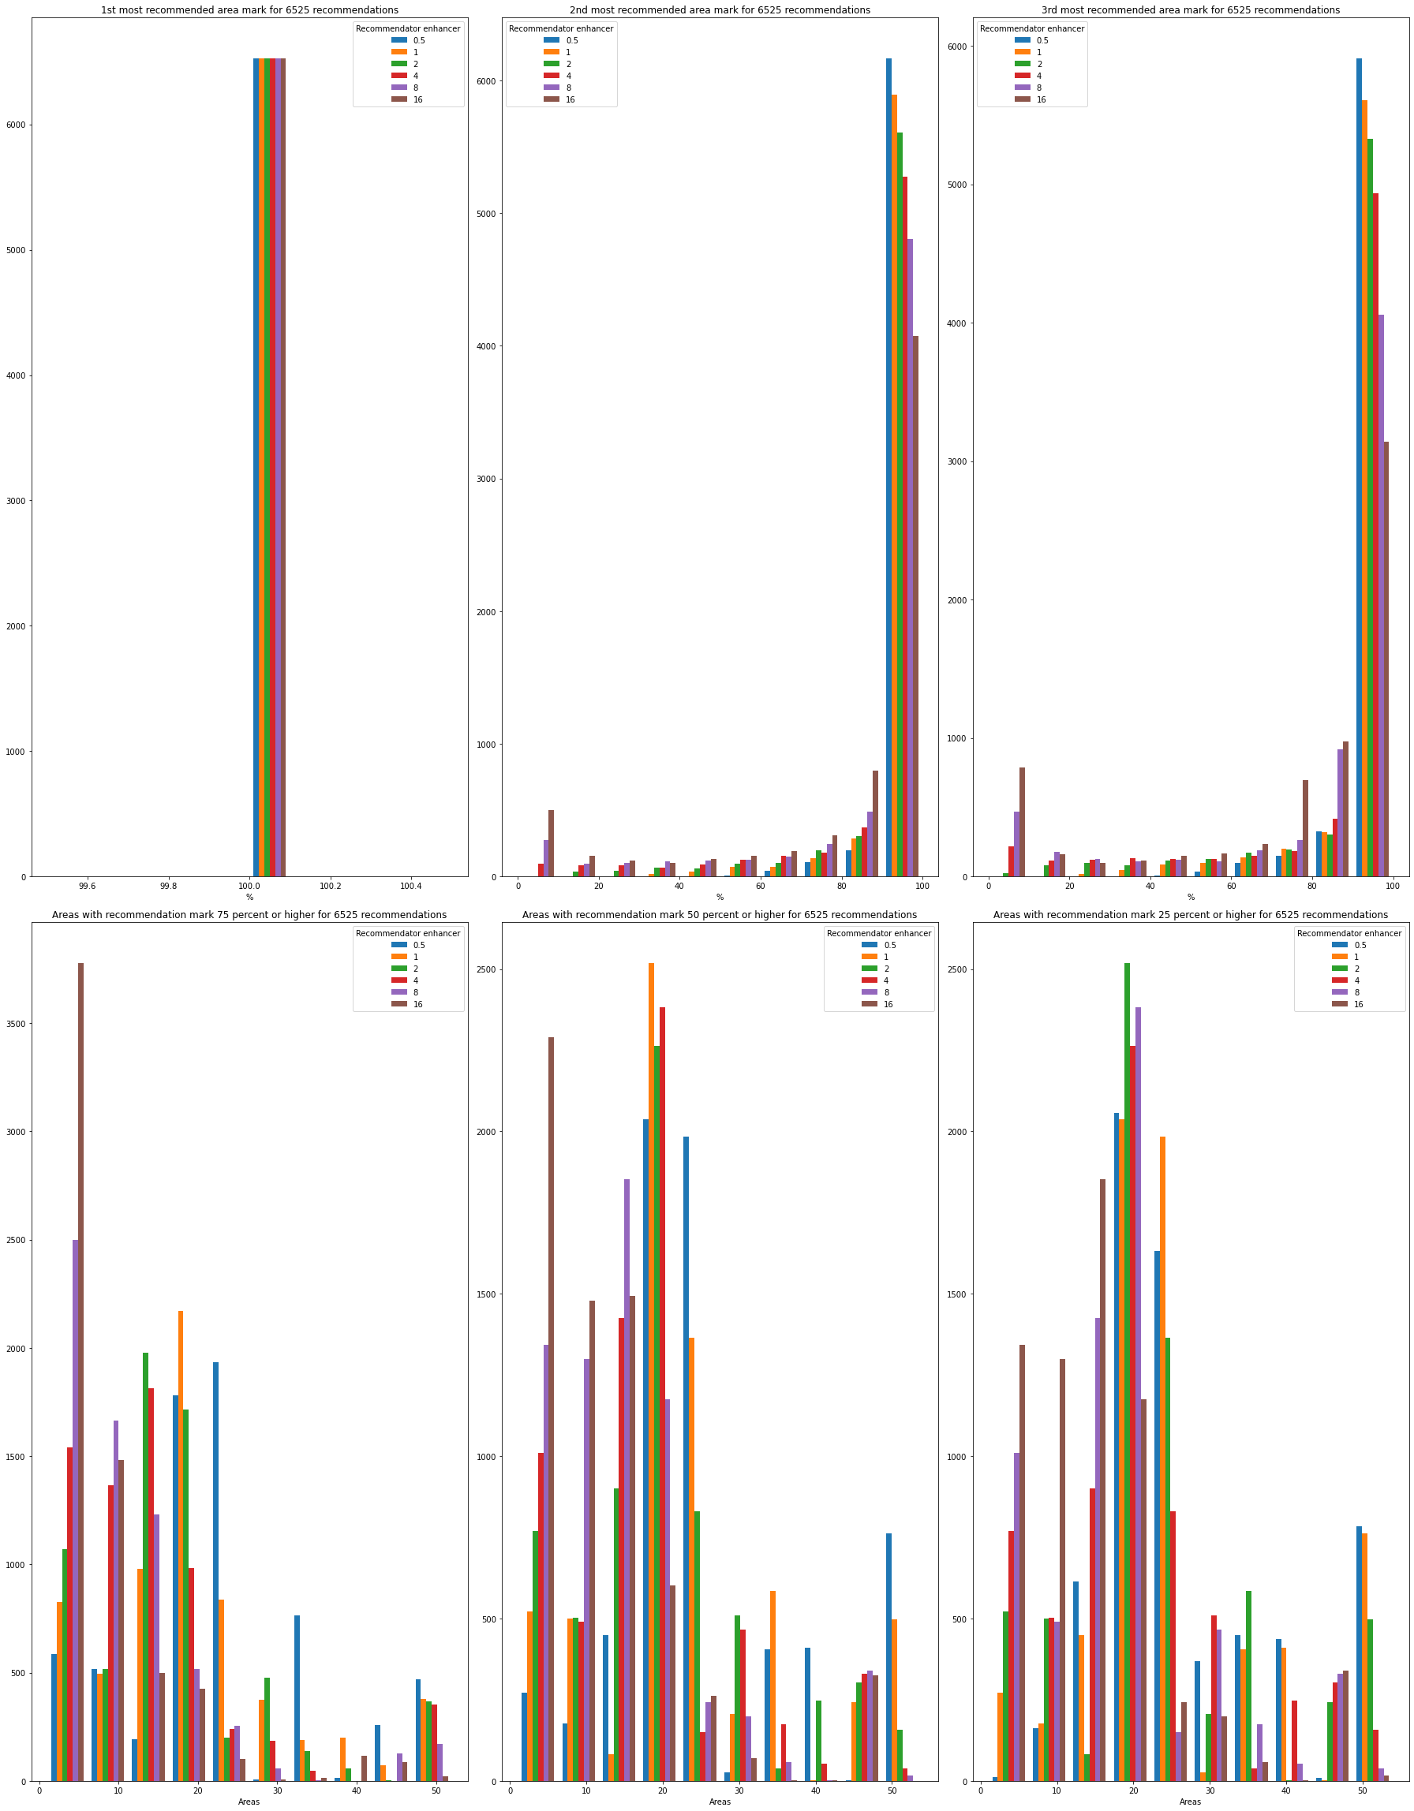
Methodology: recommendation algorithm for similarity
Testing with different recommendation enhancers.
Optimum recommendatory enhancer: 8

Slide 21
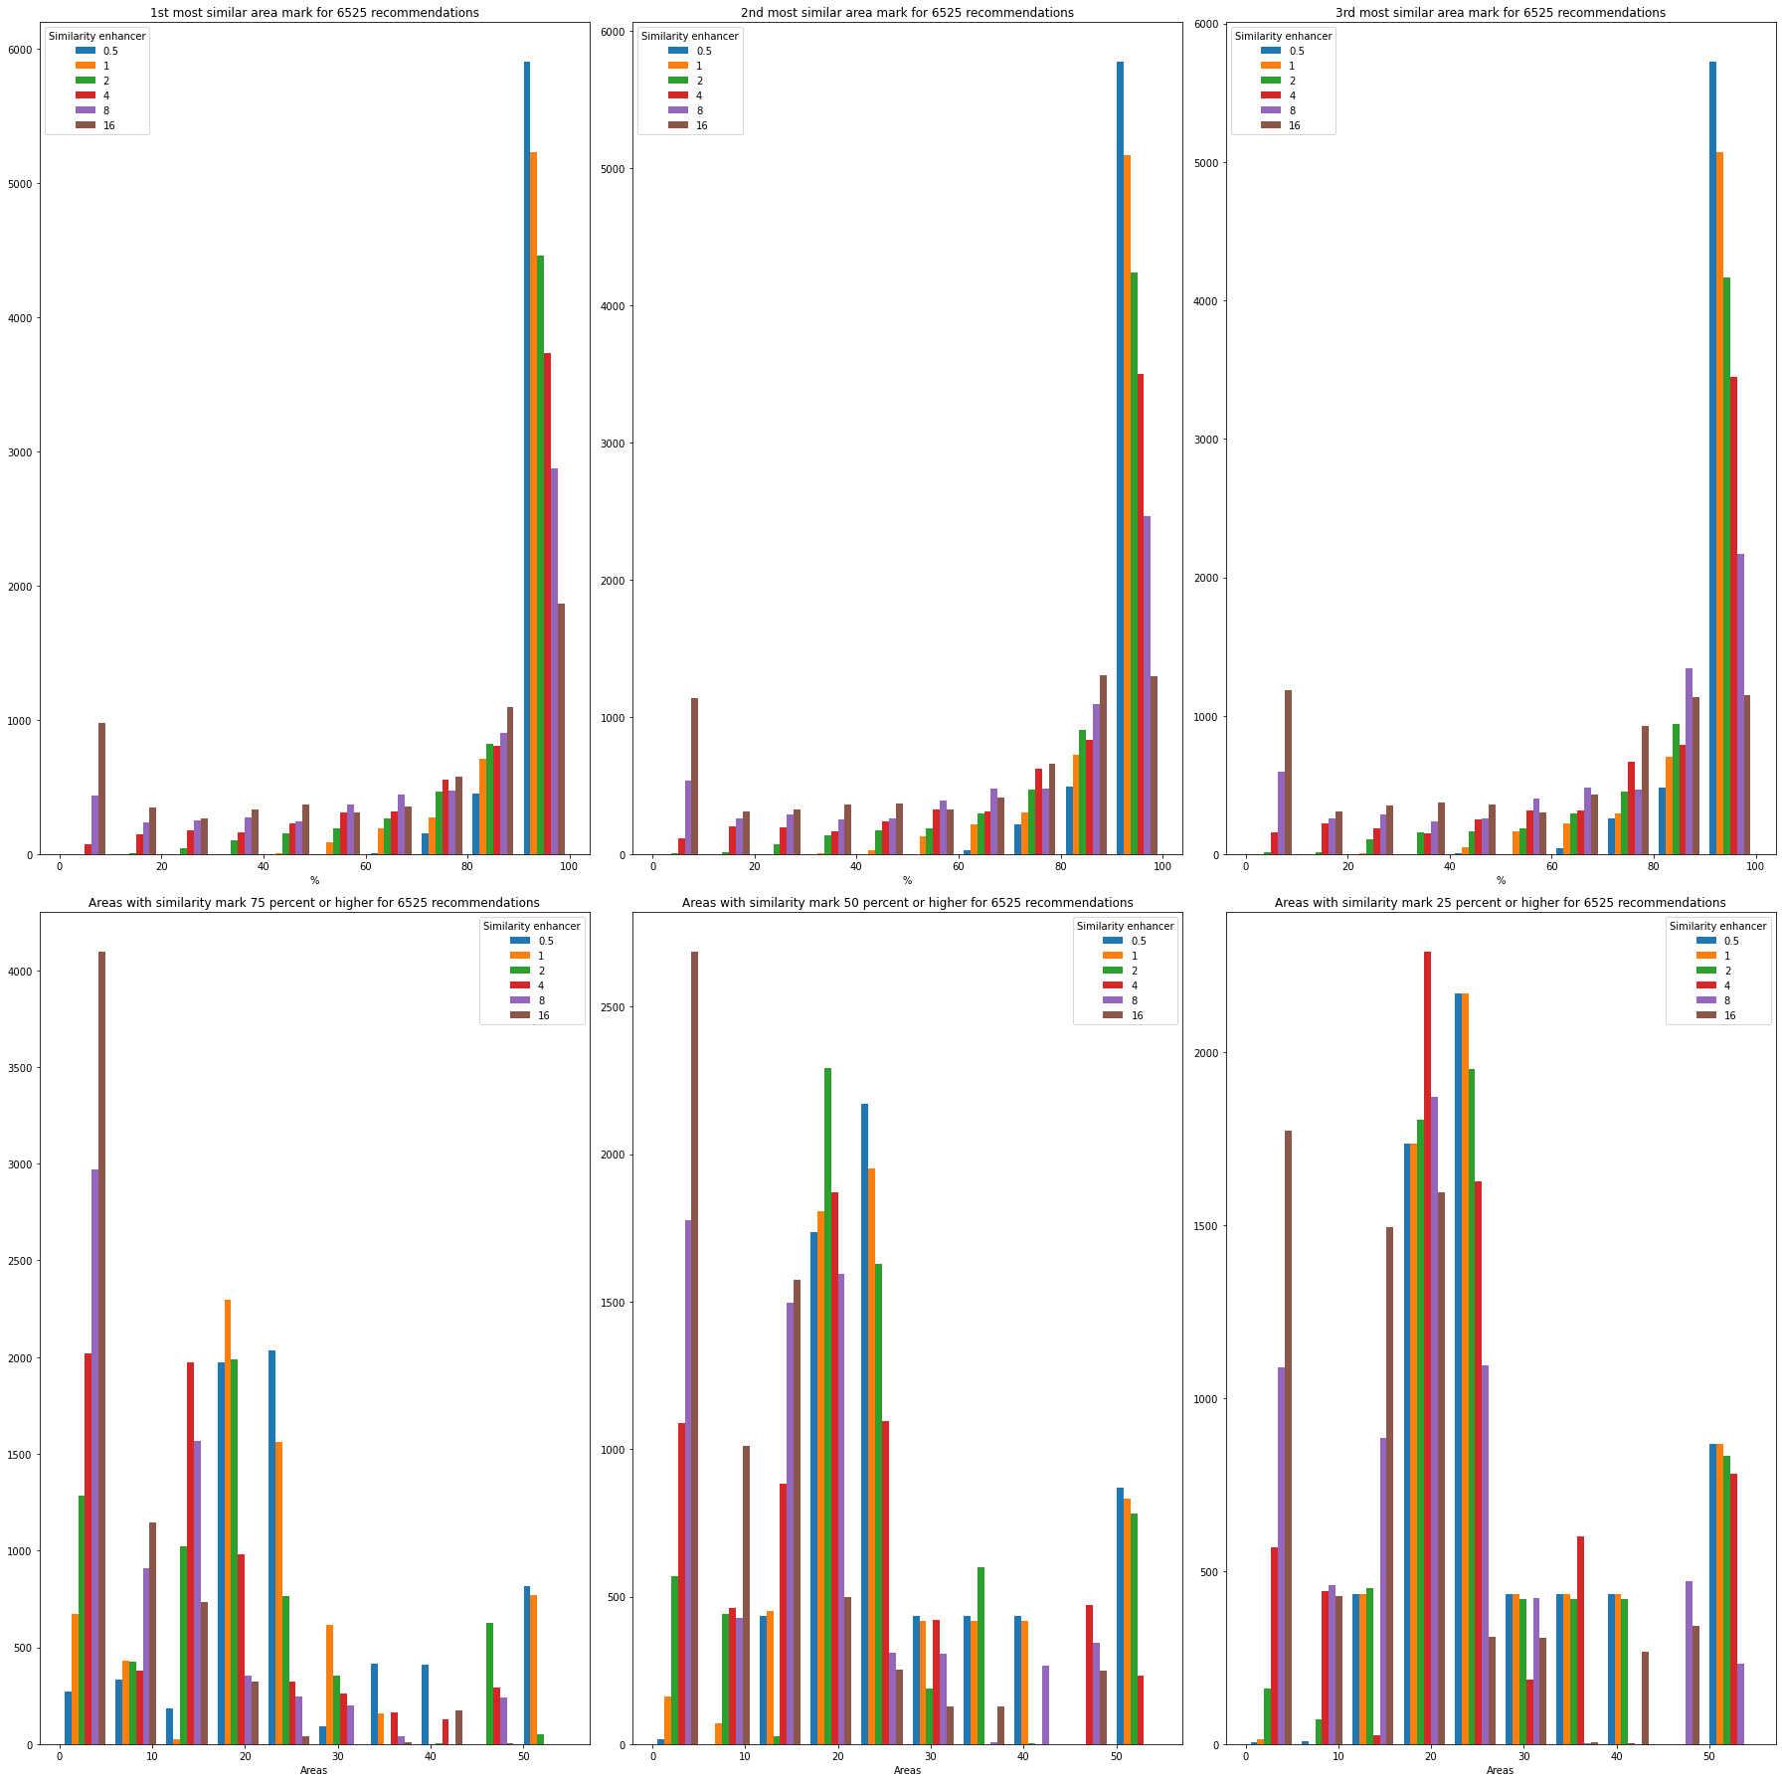
Methodology: recommendation algorithm for similarity
Testing with different similarity enhancers.
Optimum similarity enhancer: 4

Slide 22
Methodology: recommendation algorithm for density
Recommendation mark: density of venues normalized to it’s maximum, inverted and converted to percentages.
The highest the better.
Calibration through “recommendator_mark”:
Between 0 and 1: decrements differences between recommendation marks.
Over 1: increments differences between recommendation marks.
Density: array of density of venues by square kilometre for each considered postal code.

Slide 23
Methodology: recommendation algorithm for density
Testing with different recommendation enhancers.
Optimum recommendatory enhancer: 0.5

Slide 24
Methodology
Development environment
Data obtention
Data processing
Build recommendation algorithm
Build visualization tools
Build application

Slide 25
Methodology: visualization tools
Two functions implemented:
One for similarity critérium.
One for density critérium.
Both functions will show a choropleth map of a city chosen:
Postal codes remarked in green: the darker the more recommended.
Info tooltips when mouse placed over postal code area.

Slide 26
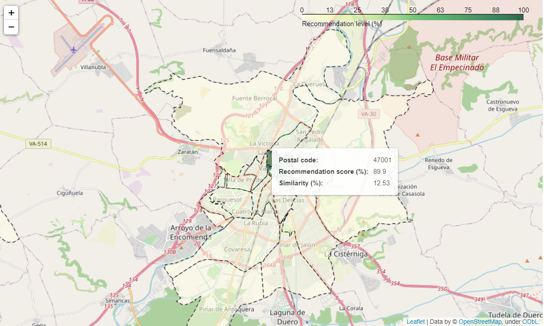
Methodology: visualization tools
Function for similarity criterium. Input:
postal_code.
city_to_movein.
venues_selected.

Slide 27
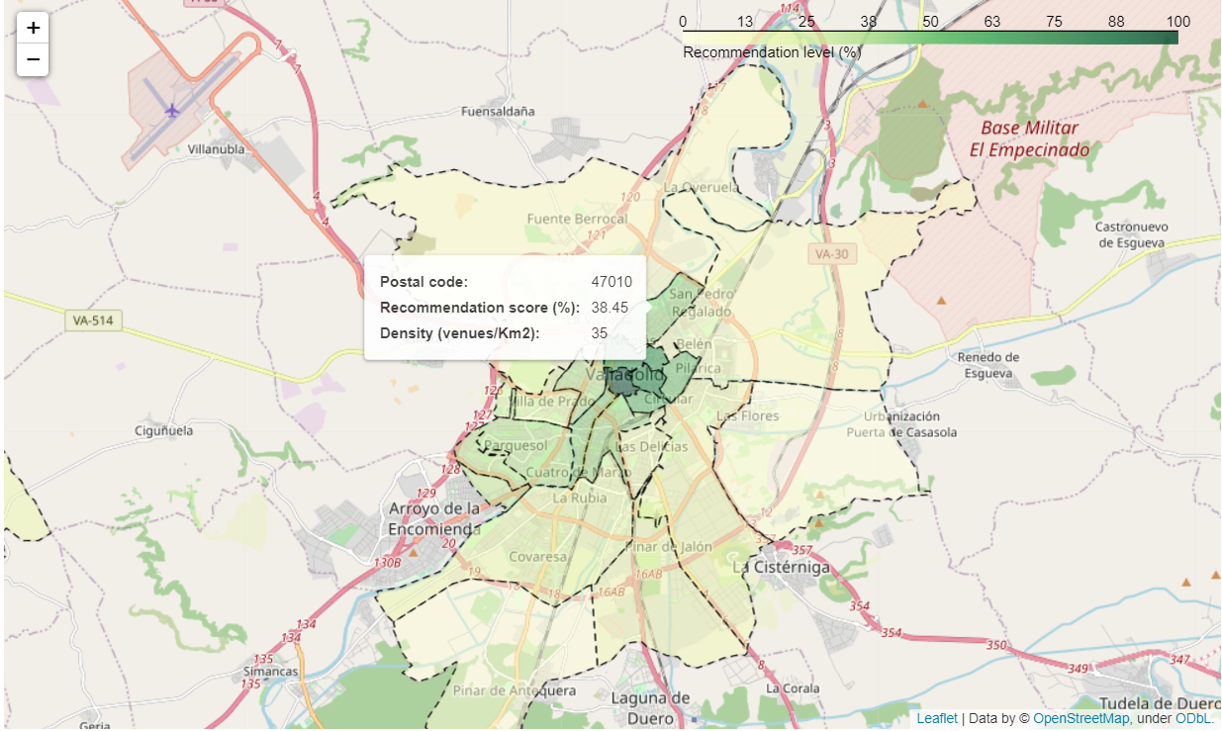
Methodology: visualization tools
Function for density criterium. Input:
city_to_movein.
venues_selected.

Slide 28
Methodology
Development environment
Data obtention
Data processing
Build recommendation algorithm
Build visualization tools
Build application

Slide 29
Methodology: application
Implemented with Ipython library.
Use of recommendation algorithm and visualization tools.
Two tabs, each one for the two criteriums.
Postal code and city selected with dropdown selectors.
Venue types selected with multiselectors.
Basic error handling.

Slide 30
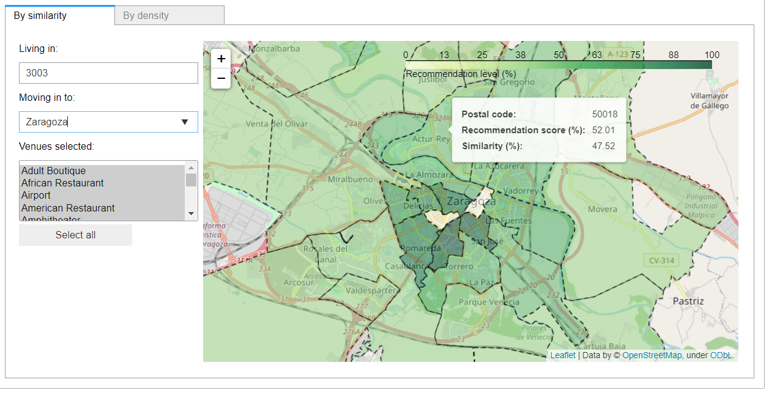
Methodology: application

Slide 31
Index
Introduction
Data to use
Methodology
Results
Discussion
Conclussions

Slide 32
Results
From exploratory analysis using application, 5 hypothesis exposed:
When using the similarity criterium:
Correlation between the distances to city centre of the reference postal code and the most recommended one.
Correlation between the most common venue type of the reference postal code and the most recommended one.
Two previous correlations can vary depending on the type of venues considered.
When using the density criterium:
Correlation between the density of venues of a postal code and the distance of the postal code from its city centre.
Previous correlation, if existing can vary depending on the type of venues considered for doing the recommendation.

Slide 33
Results: Similarity criterium
Several recommendation dones:
One for each combination of reference postal code, target city and 10 posible venue types lists to be considered (one including all).
For each recommendation, save:
Normalized distance to centre of both reference and most recommended postal codes.
Most comon venue types of both reference and most recommended postal codes.

Slide 34
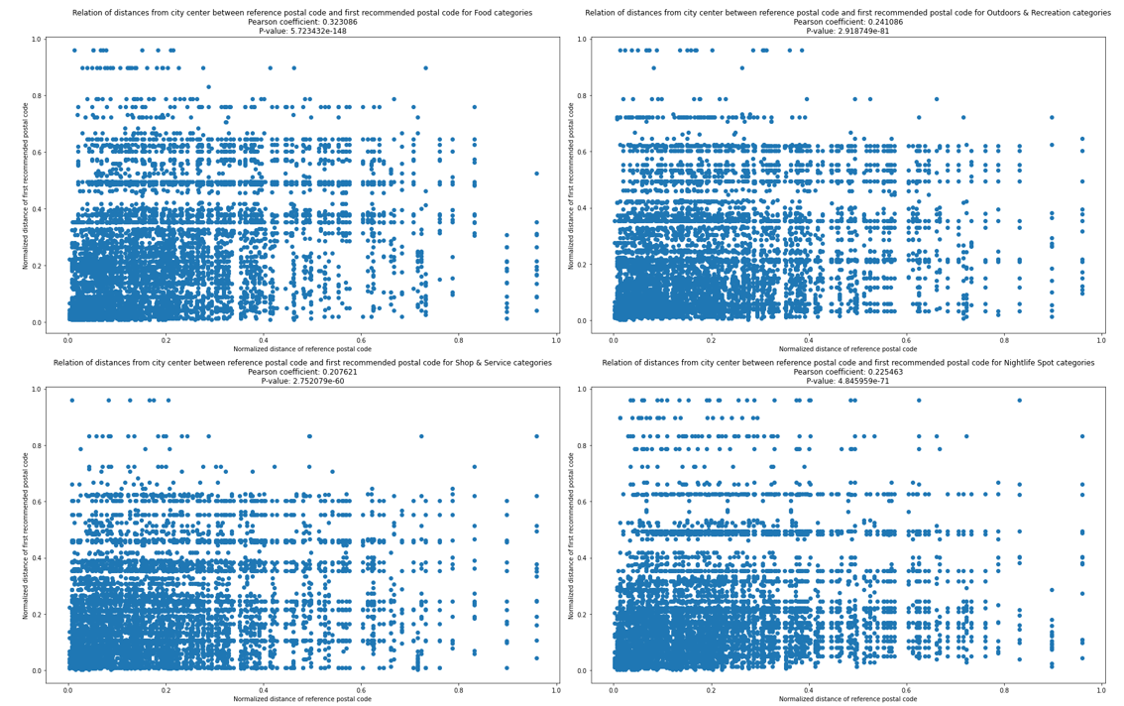
Results: Similarity criterium
Correlation between distances to data centre (Scatter and correlation):

Slide 35
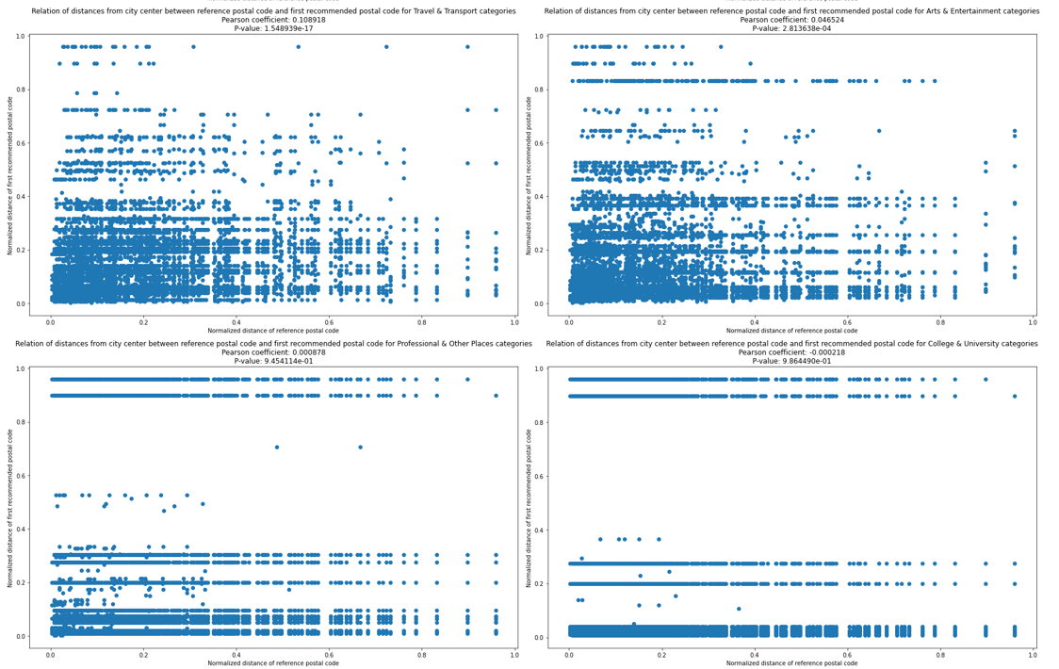
Results: Similarity criterium
Correlation between distances to data centre (Scatter and correlation) (cont.):

Slide 36
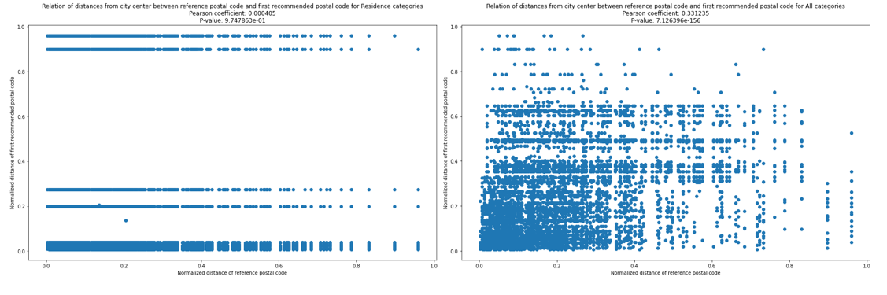
Results: Similarity criterium
Correlation between distances to data centre (Scatter and correlation) (cont.):
Interpretation:
Moderate to weak but significant positive correlation between the distances from the city centre of the reference postal code and the most recommended postal code when all categories and most of category types lists tested.
No correlation using only professional, college and residence categories.

Slide 37
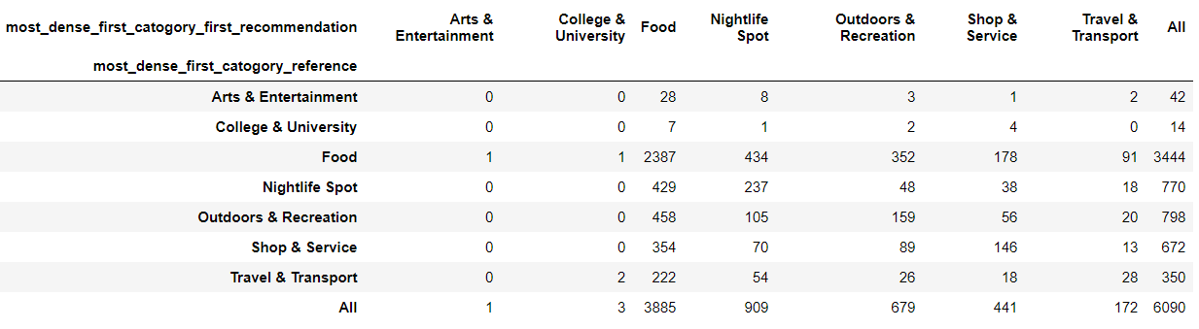
Results: Similarity criterium
Check correlation between most common venues (Chi square test):
Interpretation:
No correlation between most common venues in reference and most recommended postal codes.
Food related venues influences more thant others over the result.

Slide 38
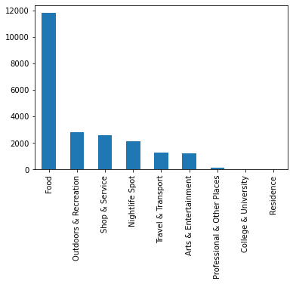
Results: Similarity criterium
Check dependency from venue types (histogram):
Interpretation:
Food related venues influences more thant others over the result.
Professional, college and residence related venues have almost no influence over the result.

Slide 39
Results: Density criterium
Several recommendation dones:
One for each combination of target city and 10 posible venue types lists to be considered (one including all).
For each recommendation, save:
Density of each of the considered postal codes.
Normalized distance to centre of each postal code.

Slide 40
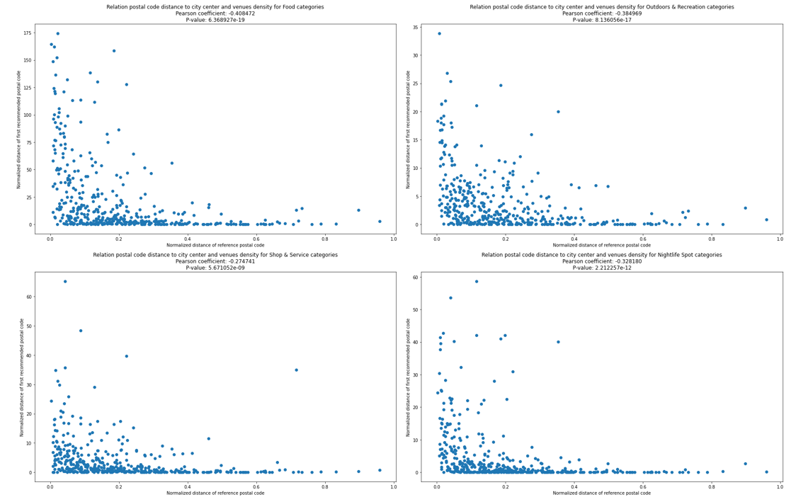
Results: Density criterium
Correlation between density and distance to data centre (Scatter and correlation):

Slide 41
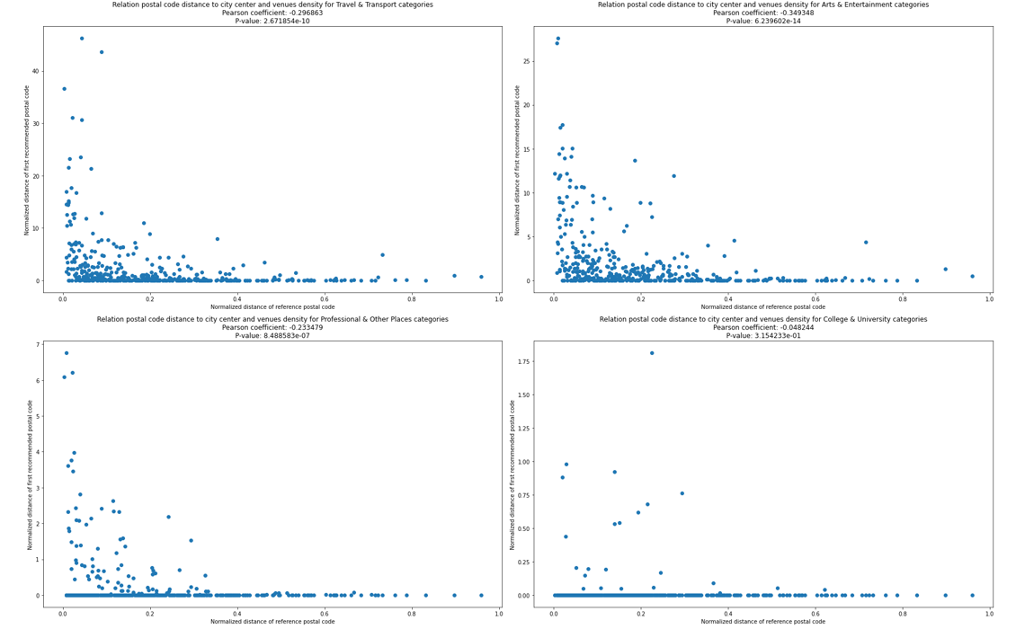
Results: Density criterium
Correlation between density and distance to data centre (cont.):

Slide 42
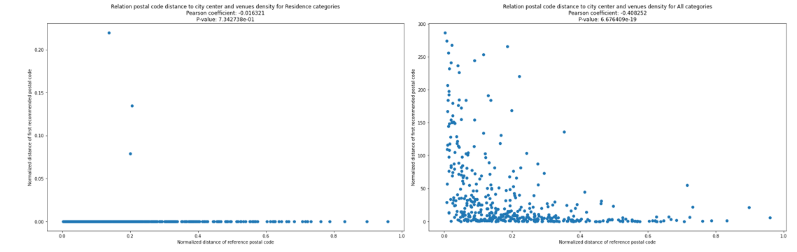
Results: Density criterium
Correlation between density and distance to data centre (cont.):
Interpretation:
Moderate to weak but significant negative correlation between the distances from the city centre of each postal code and its density in venues/Km2 when all categories and most of category types lists tested.
No correlation using only professional, residence categories.

Slide 43
Results: Density criterium
Check dependency from venue types (histogram):
Interpretation:
Food related venues influences more thant others over the result.
Professional, college and residence related venues have almost no influence over the result.

Slide 44
Index
Introduction
Data to use
Methodology
Results
Discussion
Conclusions

Slide 45
Discussion
Statements confirmed for similarity criterium:
General moderate-weak positive correlation between distances to data centre of reference postal code and most recommended one.
No correlation between most common venue types of reference postal code and most recommended one.
Food related venues are the most influential in the recommendation.
Statements confirmed for density criterium:
General moderate-weak negative correlation between density of venues of a postal code and its distance to data centre.
Food related venues are the most influential in the density and the recommendation.

Slide 46
Discussion
General result: Recommendation system is valid.
Future actions :
Increment the number of venues used or use another data source for venues, like Google Places API.
Consider the size of the venues for working out the density of venue types.
Include other information not related with venues:demographical statistics, the type of houses cost of living ...
Use smaller areas for the recommendations.
Provide additional info about each area recommended.
Add more cities to the recommendation system,:from Spain or abroad.
Enhance the visuals and error handling of the application.

Slide 47
Index
Introduction
Data to use
Methodology
Results
Discussion
Conclusions

Slide 48
Conclusions
Work done:
Data about 15 cities in Spain, postal code areas in these cities and venues at these postal codes obtained and processed for getting density of venues at postal codes.
Processed data used for creating content-based recommendation algorithm for getting recommended postal code areas in a target city to move in.
Visualization tool has been created: two functions using the recommendation algorithm for showing a choropleth map of the target city with the postal codes recommendations.
Application created: provides easy-to-use user interface for getting a recommendation.
Hypotheses exposed after an exploratory analysis and checked with statistical tools.
Statistical results used for confirming or denying the hypotheses exposed.
Previous work used for confirming the validity of the recommendation system and propose future work.
Final conclusión: Recommendation system created is valid

Slide 49

Thanks for your time

